Slide 1


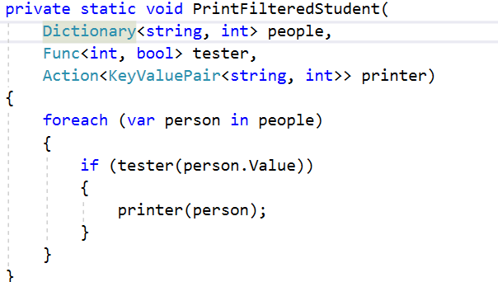


Functional Programming
Lambda Expressions
Advanced
C#
SoftUni Team
Technical Trainers
Software University
http://softuni.bg

Slide 2

Table of Contents
Functional Programming Paradigms
Lambda Expressions
Action<T>, Func<T>
Passing Functions to Methods
λ

Slide 3
Questions
sli.do #CSharp-Fund

Slide 4
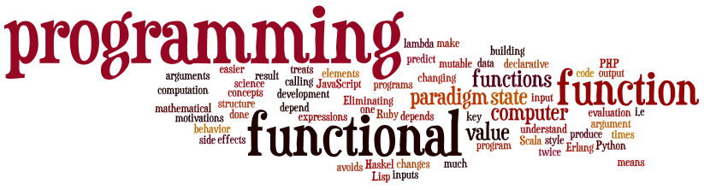
Functional Programming
Paradigms, Concepts
Notes:
Functional programming is a programming paradigm
Uses computations of mathematical functions to build programs
Declarative programming paradigm (not imperative)
Pure-functional languages (no variables and loops): Haskell
Almost-functional: Clojure, Lisp, Scheme, Scala, F#, JavaScript
Imperative with functional support: C#, Python, Ruby, PHP, Java
Non-functional: C, Pascal, the old versions of C#, Java, C++, PHP

Slide 5
What is Function?
Mathematic function
f(x) = x²
x
f(x)
Name
3 | 9
1 | 1
0 | 0
4 | 16
-4 | 16
Input
Output
A function is a special relationship where each input has a single output.

Slide 6

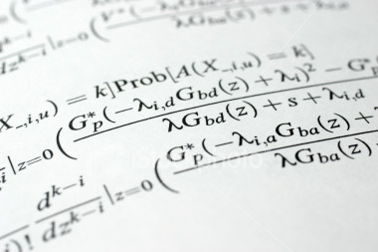
Lambda Expressions

Slide 7
Lambda Expressions
A lambda expression is an unnamed function with parameters and a body
Lambda syntax
Use the lambda operator =>
Read as "goes to"
Parameters can be enclosed in parentheses ()
The body holds the expression or statement and can be enclosed in braces {}
(parameters) => {body}

Slide 8
Lambda Expressions (2)
Implicit lambda expression
Explicit lambda expression
Zero parameters
More parameters
msg => Console.WriteLine(msg);
(String msg) => { Console.WriteLine(msg); }
() => { Console.WriteLine("hi"); }
(int x, int y) => { return x + y; }

Slide 9

Problem: Sort Even Numbers
Read Integers from console
Print even numbers sorted in increasing order
Use 2 Lambda Expresions
4, 2, 1, 3, 5, 7, 1, 4, 2, 12
2, 2, 4, 4, 12

Slide 10
Solution: Sort Even Numbers
int[] numbers = Console.ReadLine()
.Split(new string[] { ", " },
StringSplitOptions.RemoveEmptyEntries)
.Select(n => int.Parse(n))
.Where(n => n % 2 == 0)
.OrderBy(n => n)
.ToArray();
string result = string.Join(", ", numbers);
Console.WriteLine(result);
Check your solution here: https://judge.softuni.bg/Contests/Practice/Index/597#0

Slide 11
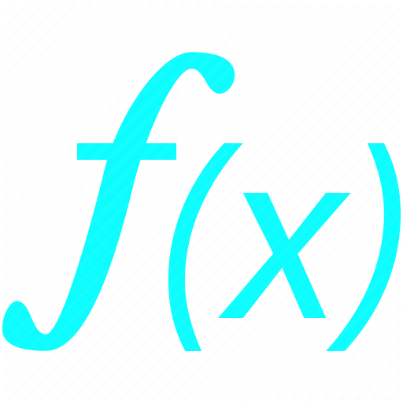




Delegates
Func<T>, Action<T>
Notes:
Functional programming is a programming paradigm
Uses computations of mathematical functions to build programs
Declarative programming paradigm (not imperative)
Pure-functional languages (no variables and loops): Haskell
Almost-functional: Clojure, Lisp, Scheme, Scala, F#, JavaScript
Imperative with functional support: C#, Python, Ruby, PHP, Java
Non-functional: C, Pascal, the old versions of C#, Java, C++, PHP

Slide 12
C# Functions
Lambda Expressions
Initialization of function
Input and output type can be different type
Input and output type must be from type which we declare them
Func<int, string> func = n => n.ToString();
Input type
Output type
Name
Input parameter
Return expression

Slide 13
Action<T>
In .NET Action<T> is a void method:
Instead of writing the method we can do:
Then we use it like that:
private void Print(string message)
{ Console.WriteLine(message); }
Action<string> print = message => Console.WriteLine(message);
print("pesho");
print(5.ToString());

Slide 14
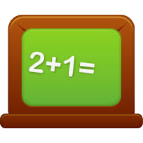

Problem: Sum Numbers
Read numbers from console
Use your own Function for parse
Print Count of numbers
Print Sum
4, 2, 1, 3, 5, 7, 1, 4, 2, 12
10
41

Slide 15
Solution: Sum Numbers
string input = Console.ReadLine();
Func<string, int> parser = n => int.Parse(n);
int[] numbers = input.Split(new string[] {", "},
StringSplitOptions.RemoveEmptyEntries)
.Select(parser).ToArray();
Console.WriteLine(numbers.Length);
Console.WriteLine(numbers.Sum());
Check your solution here: https://judge.softuni.bg/Contests/Practice/Index/597#1

Slide 16

Problem: Count Uppercase Words
Read text from console
Count how many words start with Uppercase
Print count and words
Use Predicate
The following example shows how to use Predicate
The
Predicate

Slide 17
Solution: Count Uppercase Words
var words = Console.ReadLine().Split(new string[] {" "},
StringSplitOptions.RemoveEmptyEntries);
Func<string, bool> checker = n => n[0] == n.ToUpper()[0];
words.Where(checker)
.ToList()
.ForEach(n => Console.WriteLine(n));
Check your solution here: https://judge.softuni.bg/Contests/Practice/Index/597#2

Slide 18


Problem: Add VAT
Read from console some item's prices
Add VAT of 20% to all of them
Use UnaryOperator
Prices with VAT:
1,66
3,07
5,28
1.38, 2.56, 4.4

Slide 19
Solution: Add VAT
Console.ReadLine()
.Split(new string[] { ", " },
StringSplitOptions.RemoveEmptyEntries)
.Select(double.Parse)
.Select(n => n * 1.2)
.ToList()
.ForEach(n => Console.WriteLine($"{n:n2}"));
Check your solution here: https://judge.softuni.bg/Contests/Practice/Index/597#3

Slide 20
Passing Functions to Method
We can pass Func<T> to methods:
We can use the method like that:
private int Operation(int number, Func<int, int> operation)
{
return operation(number);
}
int a = 5;
int b = Operation(a, number => number * 5);
int c = Operation(a, number => number – 3);
int d = Operation(b, number => number % 2);

Slide 21
Problem: Filter by Age
Read from console n people with their age
Read condition and age for filter
Read format type for output
Print all people that fulfills the condition
Pesho | 20
Gosho | 18
Radka | 29
Mara | 32
Izdislav | 16
Condition - "older"
Age - 20
Format - "name age"
Pesho | 20
Radka | 29
Mara | 32

Slide 22
Solution: Filter by Age
//TODO: Read info from console
//Implementation of these methos on next slides
Func<int, bool> tester = CreateTester(condition, age);
Action<KeyValuePair<string, int>> printer =
CreatePrinter(format);
PrintFilteredStudent(people, tester, printer);
Check your solution here: https://judge.softuni.bg/Contests/Practice/Index/597#4

Slide 23
Solution: Filter by Age (2)
public static Func<int, bool> CreateTester
(string condition, int age)
{
switch (condition)
{
case "younger": return x => x < age;
case "older": return x => x >= age;
default: return null;
}
}
Check your solution here: https://judge.softuni.bg/Contests/Practice/Index/597#4

Slide 24
Solution: Filter by Age (3)
public static Action<KeyValuePair<string, int>>
CreatePrinter(string format)
{
switch (format)
case "name":
return person => Console.WriteLine($"{person.Key}");
case "age":
return person => Console.WriteLine($"{person.Value}");
case "name age":
return person =>
Console.WriteLine($"{person.Key} - {person.Value}");
default: return null;
}
Check your solution here: https://judge.softuni.bg/Contests/Practice/Index/597#4

Slide 25
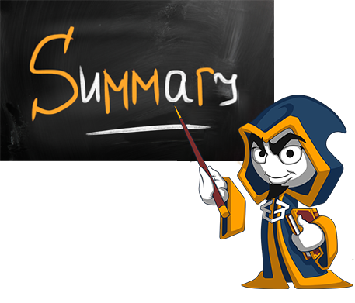
Summary
Lambda expressions are anonymous functions used with delegates
Action<T> is a void function
Func<T, TResult> is a function that returns TResult type

Slide 26







Functional Programming
https://softuni.bg/courses/csharp-advanced

Slide 27
License
This course (slides, examples, demos, videos, homework, etc.) is licensed under the "Creative Commons Attribution-NonCommercial-ShareAlike 4.0 International" license
Attribution: this work may contain portions from
"Fundamentals of Computer Programming with C#" book by Svetlin Nakov & Co. under CC-BY-SA license
"C# Part I" course by Telerik Academy under CC-BY-NC-SA license
"C# Part II" course by Telerik Academy under CC-BY-NC-SA license

Slide 28





Trainings @ Software University (SoftUni)
Software University – High-Quality Education, Profession and Job for Software Developers
softuni.bg
Software University Foundation
http://softuni.foundation/
Software University @ Facebook
facebook.com/SoftwareUniversity
Software University Forums
forum.softuni.bg

